Slide 1

Azure cognitive search: The next generation

Slide 2






GRACIAS!

Slide 3




Nosotros
David Vidal Castillo
Sergio Parra Guerra
Team Lead at Encamina
@D_Vid_45
Software Architect at Encamina
@sparraguerra

Slide 4

Agenda
Cómo era Azure Search
Qué es Azure Cognitive Search
Indice de búsqueda
Datasource
Cognitive skills
Skillset
Custom skills
Indexer
Demo

Slide 5

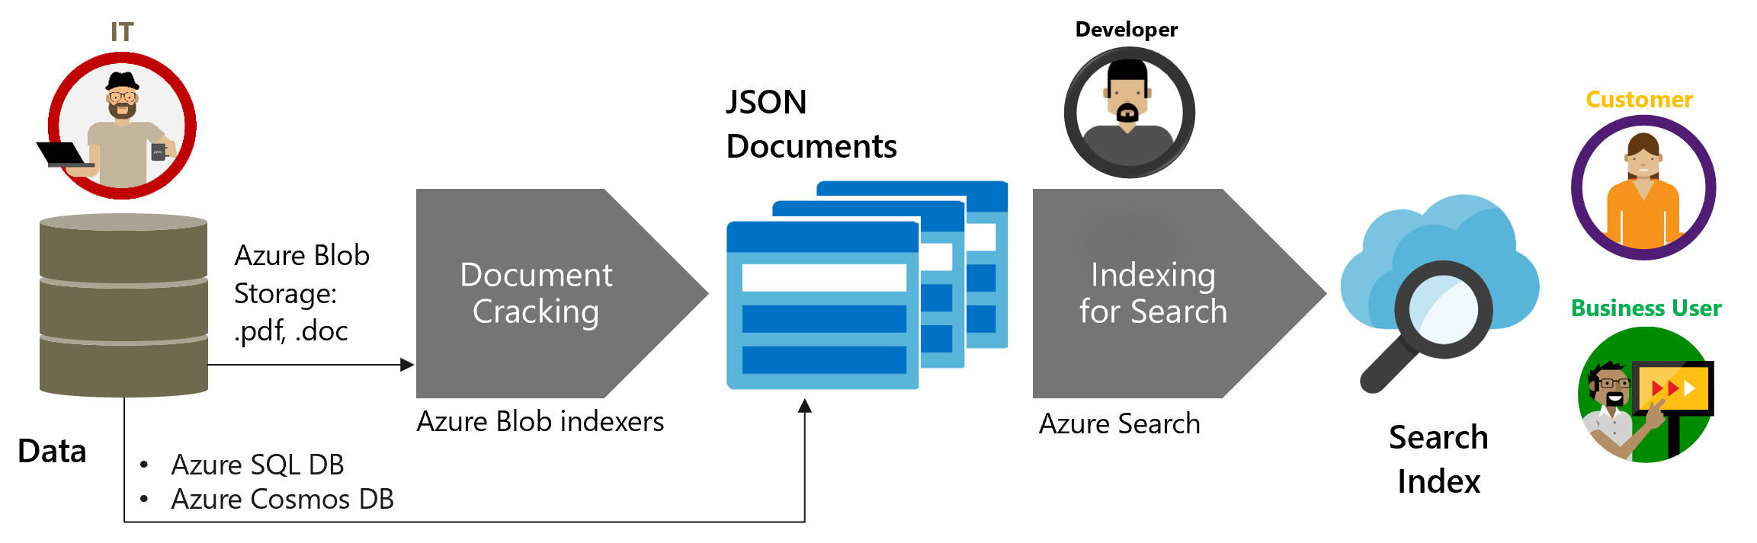
Azure search: The beginning

Slide 6


¿Qué es Azure Cognitive Search?
Una solución de búsqueda-como-servicio que permite a los desarrolladores incorporar experiencias de búsquedas enriquecidas con AI en las aplicaciones sin necesidad de infraestructura.
“AI Enriched Search”

Slide 7


Azure Cognitive Search: The next generation
Servicio de búsqueda en la nube que ofrece a los desarrolladores las APIS y herramientas necesarias para agregar una experiencia de búsqueda enriquecida y de fácil integración en las aplicaciones
Soporte para sintaxis Lucene y OData
Facets
Cantidad de ocurrencias de un mismo valor en un metadata determinado.
Filtros y búsquedas por texto
Realizar diferentes tipos de búsquedas en función de cómo configures tu índice.
Geolocalización
Búsquedas por proximidad a un punto determinado.
Estructura JSON
Estructura no acotada abierta al “cambio”

Slide 8
Cognitive Search Pattern
Ingest
Enrich
Explore
Data in any format, any Azure store
Skillset
Search
Annotations
Notes:
Even as we take in all of this complexity, as we looked at these challenges, we saw a common pattern emerge:
INGEST (Understanding documents in a variety of format)
AUGMENT (Extract “information”, Create structure out of the unstructured.)
EXPLORE (Search)
INGEST (Understanding documents in a variety of formats)
ENRICH (Extract “information”, Create structure out of the unstructured, find patterns, gain understanding across multiple document types)
EXPLORE (Search intelligently to create knowledge from disparate documents, and structured and unstructured data)

Slide 9

Cognitive Search A new capability of Azure Search
IEnricher
IEnricher
Cognitive Skill
Document Cracking
Skillset:
Extensible enrichment
pipeline
Source Data
Enriched Documents
Search Index
INGEST
ENRICH
EXPLORE
Notes:
New!!
As you saw, the Cognitive Search pipeline contains a number of AI-driven capabilities (image extraction, entity and key phrase extraction, language detection and more) not just extracting information, but enriching it with additional metadata.
But we know that you business scenario may have unique needs beyond these core skills, so we also provide you with the ability to add custom skills…..

Slide 10
Cognitive Search A new capability of Azure Search
IEnricher
IEnricher
Cognitive Skill
Document Cracking
Skillset:
Extensible enrichment
pipeline
Source Data
Enriched Documents
Search Index
INGEST
ENRICH
EXPLORE
Notes:
New!!
As you saw, the Cognitive Search pipeline contains a number of AI-driven capabilities (image extraction, entity and key phrase extraction, language detection and more) not just extracting information, but enriching it with additional metadata.
But we know that you business scenario may have unique needs beyond these core skills, so we also provide you with the ability to add custom skills…..

Slide 11
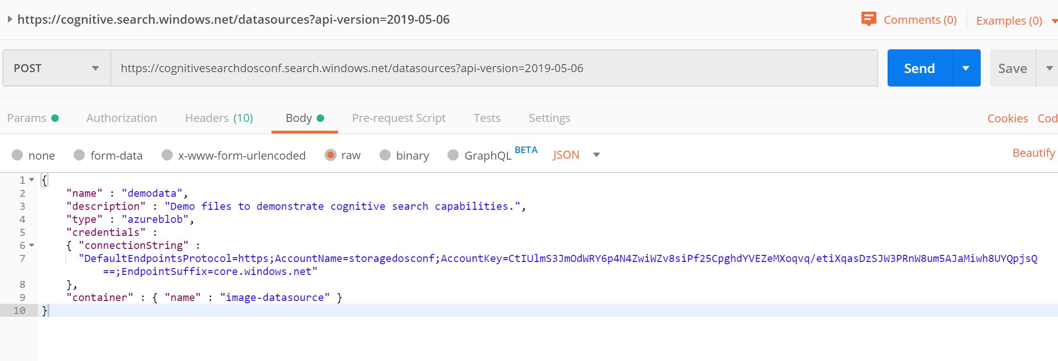
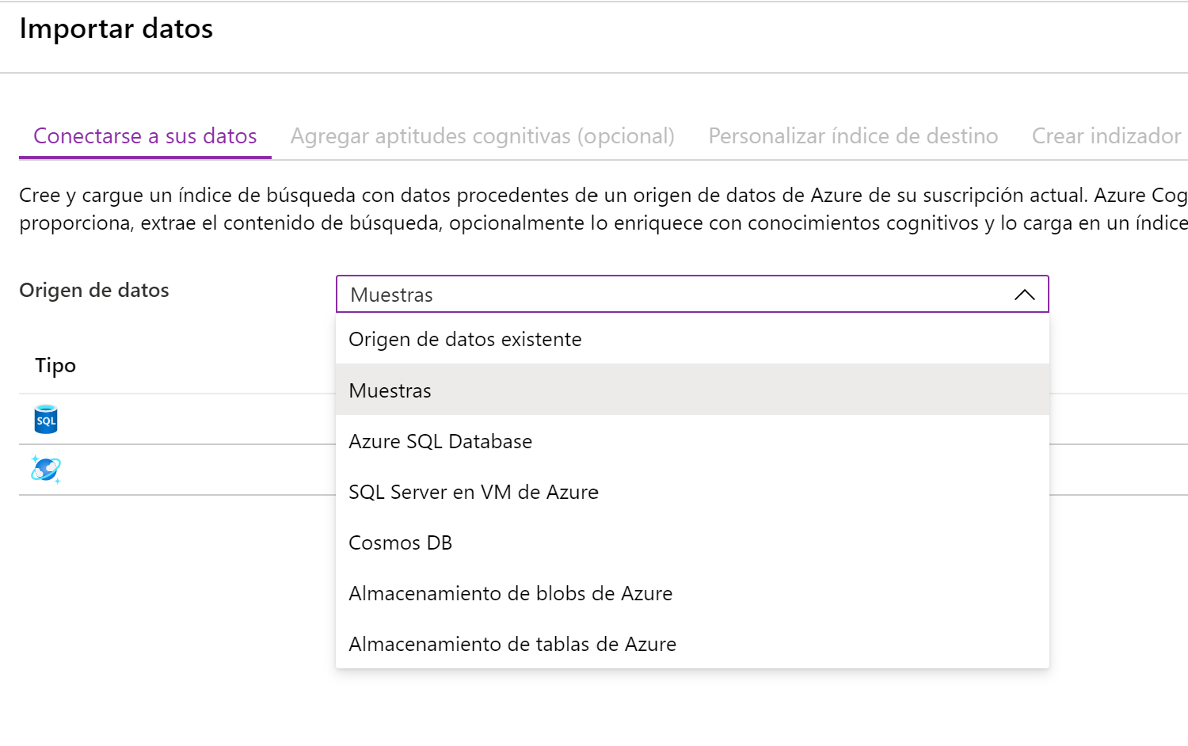
Data source
Azure SQL
Azure Cosmos DB
Azure Blob Storage
Azure Table Storage

Slide 12
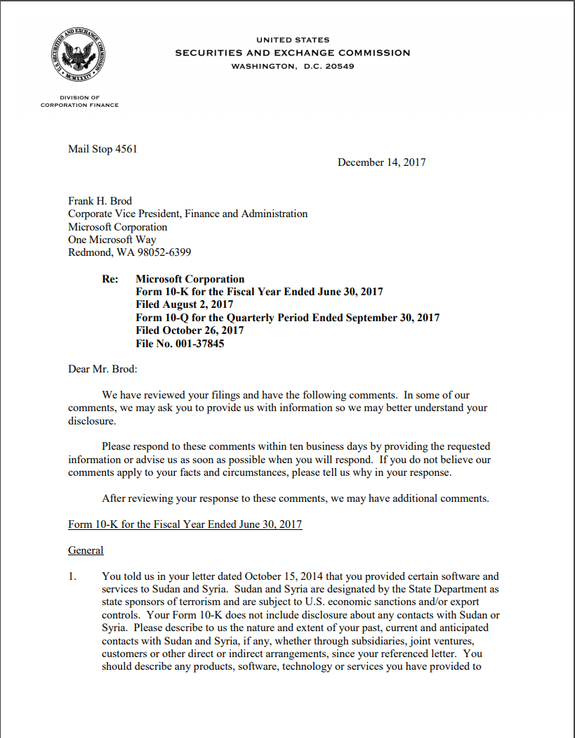

Document Cracking
Built-in connectors
Blob Storage
Azure SQL
Cosmos DB
Azure Tables
ADLS Gen2 (new! - gated public preview!)
File formats supported in blob storage
text
metadata
images
pdf
xml
png
rtf
json
html
doc
ppt
xls
jpg
tiff
bmp
Notes:
MongoDB?

Slide 13
Cognitive Search A new capability of Azure Search
IEnricher
IEnricher
Cognitive Skill
Document Cracking
Skillset:
Extensible enrichment
pipeline
Source Data
Enriched Documents
Search Index
INGEST
ENRICH
EXPLORE
Notes:
New!!
As you saw, the Cognitive Search pipeline contains a number of AI-driven capabilities (image extraction, entity and key phrase extraction, language detection and more) not just extracting information, but enriching it with additional metadata.
But we know that you business scenario may have unique needs beyond these core skills, so we also provide you with the ability to add custom skills…..

Slide 14




Cognitive skills
Built-in skills
Custom skills
Key Phrase extraction
Location entity extraction
Sentiment analysis
Your custom skill goes here!
Organization entity extraction
Persons entity extraction
Language detection
Face detection
Celebrity recognition
Image tag extraction
Text Utilities
Landmark detection
Printed text recognition
Azure Databricks
Azure Machine Learning
Machine Learning VMs

Slide 15
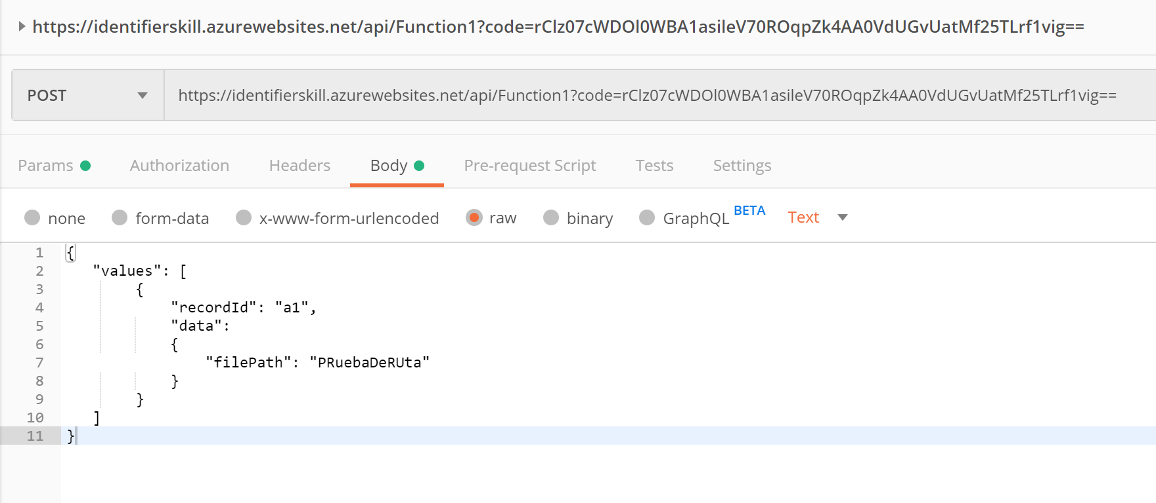
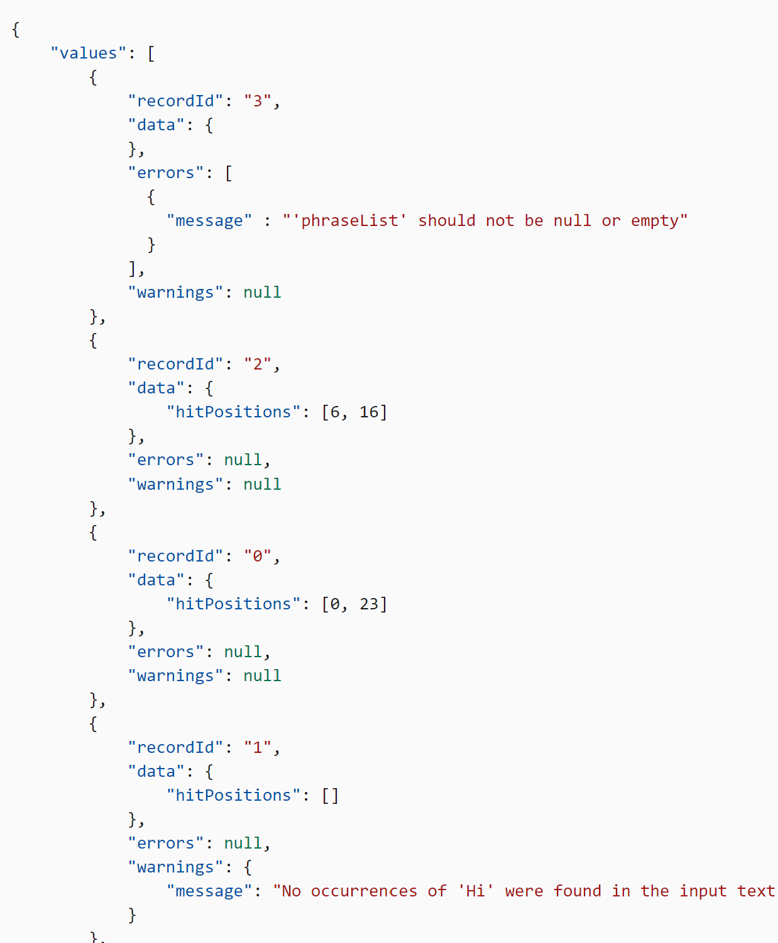

Custom skill
Interfaz de request y response definidos.
Permite ampliar la funcionalidad de una colección de habilidades con operaciones personalizadas.
Desplegable y escalable mediante la tecnología de Azure Functions.

Slide 16
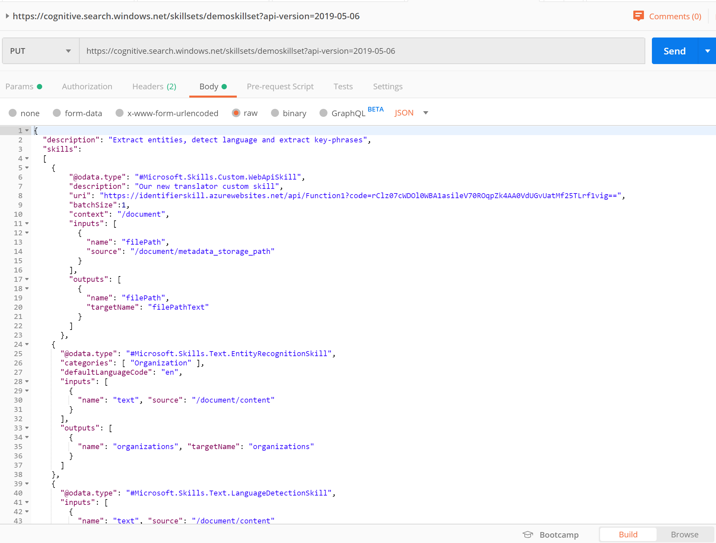
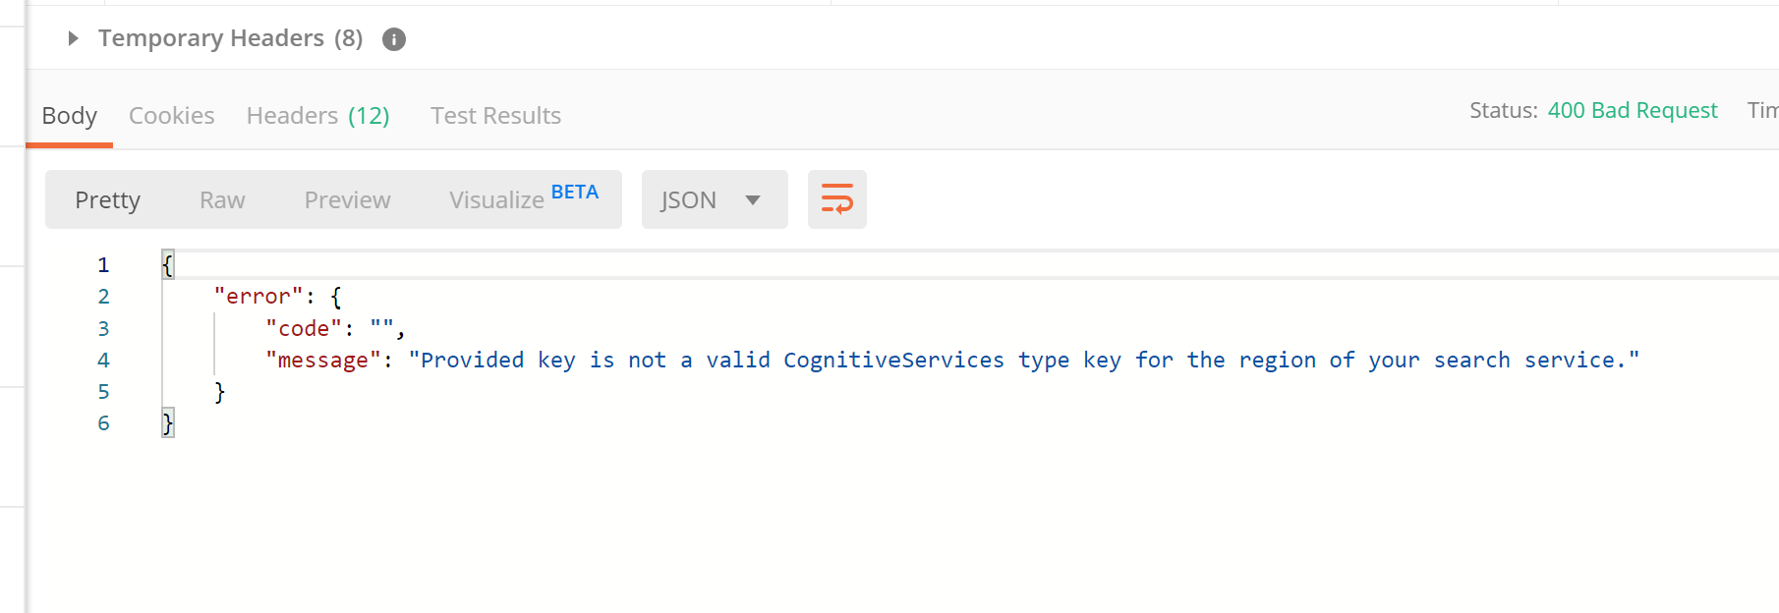
Skillset
Agrupa y relaciona resultados de las habilidades.
Habilidades personalizadas.
Reutilizable en otros indexadores.

Slide 17
Cognitive Search A new capability of Azure Search
IEnricher
IEnricher
Cognitive Skill
Document Cracking
Skillset:
Extensible enrichment
pipeline
Source Data
Enriched Documents
Search Index
INGEST
ENRICH
EXPLORE
Notes:
New!!
As you saw, the Cognitive Search pipeline contains a number of AI-driven capabilities (image extraction, entity and key phrase extraction, language detection and more) not just extracting information, but enriching it with additional metadata.
But we know that you business scenario may have unique needs beyond these core skills, so we also provide you with the ability to add custom skills…..

Slide 18
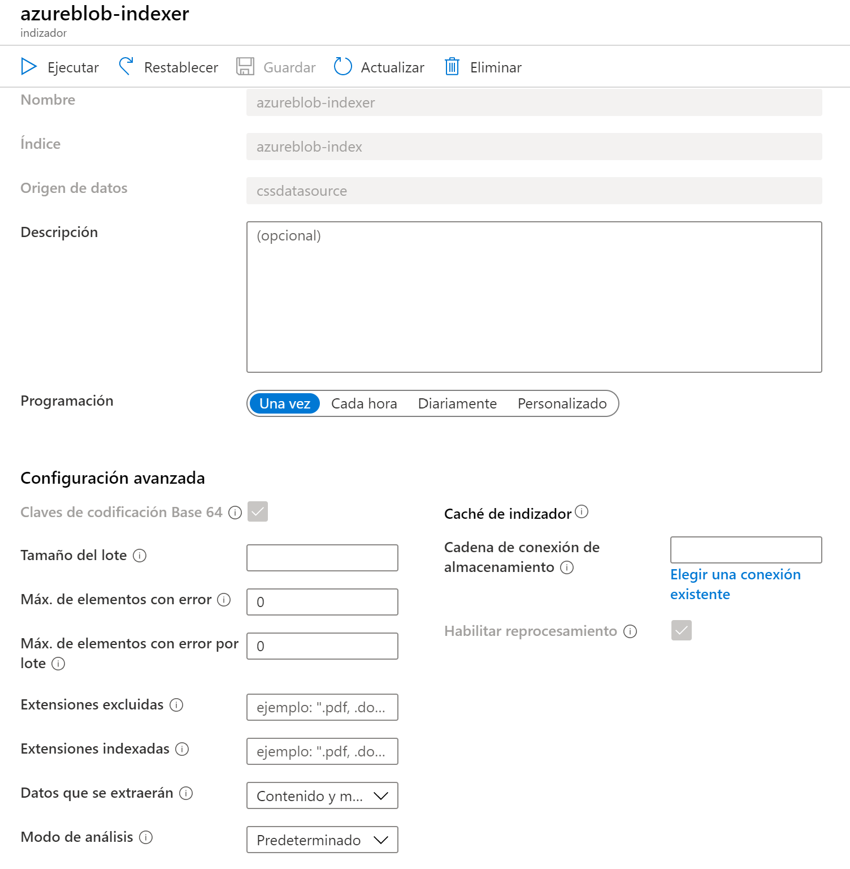
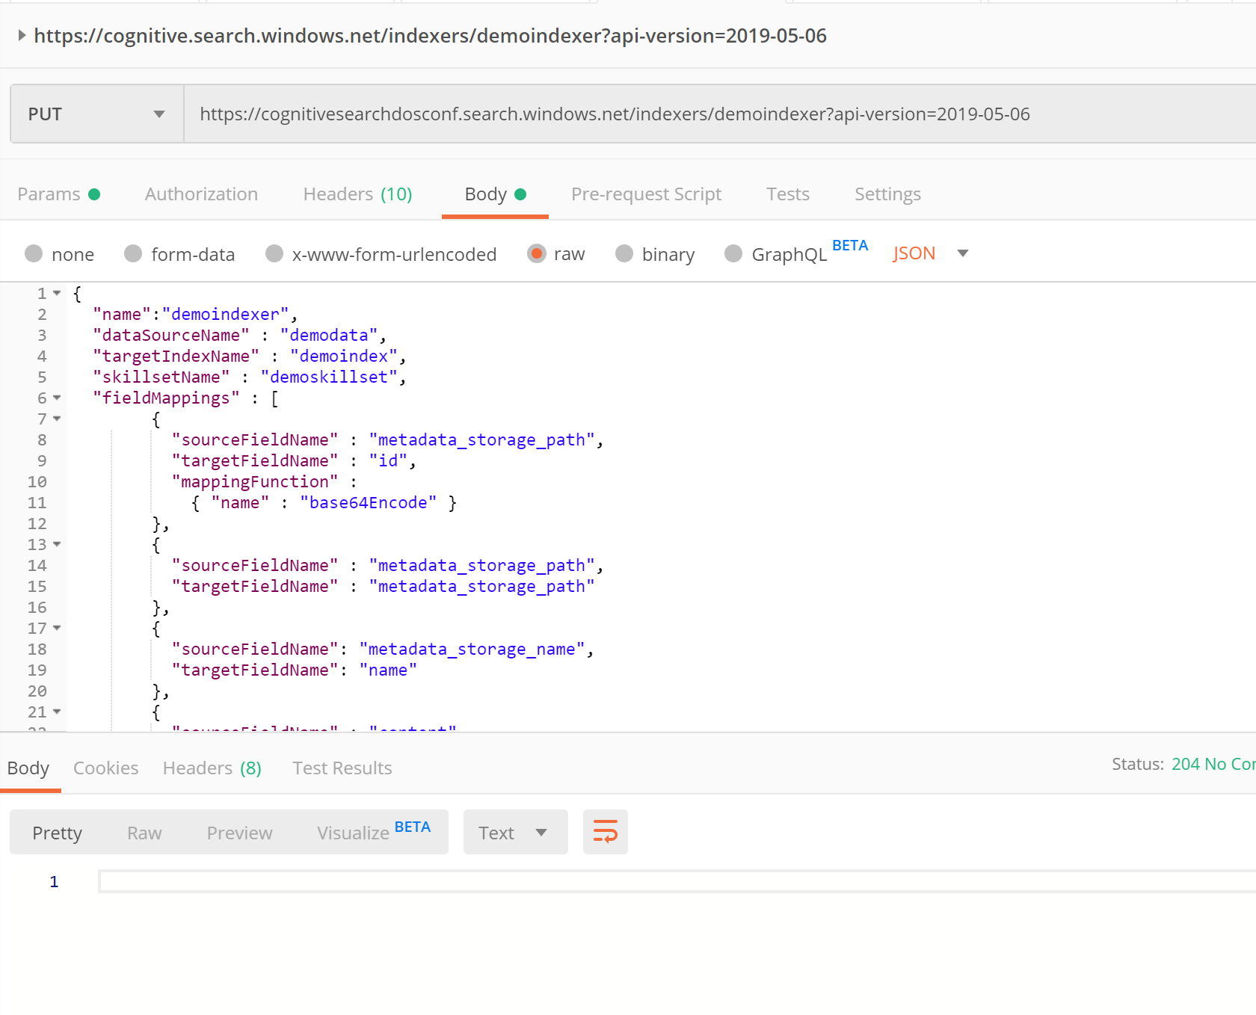
Indexer
Relaciona los diferentes elementos.
Mapea los resultados del skillset contra los campos del índice.
Permite realizar pequeñas transformaciones previas al indexado.

Slide 19

API REST en Azure

Slide 20
Cognitive Search A new capability of Azure Search
IEnricher
IEnricher
Cognitive Skill
Document Cracking
Skillset:
Extensible enrichment
pipeline
Source Data
Enriched Documents
Search Index
INGEST
ENRICH
EXPLORE
Notes:
New!!
As you saw, the Cognitive Search pipeline contains a number of AI-driven capabilities (image extraction, entity and key phrase extraction, language detection and more) not just extracting information, but enriching it with additional metadata.
But we know that you business scenario may have unique needs beyond these core skills, so we also provide you with the ability to add custom skills…..

Slide 21

Cognitive Search A new capability of Azure Search
IEnricher
IEnricher
Cognitive Skill
Document Cracking
Skillset:
Extensible enrichment
pipeline
Source Data
Enriched Documents
Search Index
Projections
Knowledge Store
Notes:
We had this capability on preview for a year, and during that period of time customers told us that they really enjoyed the seamless integration. They told us that the structure that we were feeding into the search index could be super useful for them for scenarios beyond search.
I am happy to announce that we added a new capability that we call the knowledge store that allows you to project the tree of information into both tabular and object shapes.

Slide 22



Cognitive Search A new capability of Azure Search
IEnricher
IEnricher
Cognitive Skill
Document Cracking
Skillset:
Extensible enrichment
pipeline
Source Data
Enriched Documents
Search Index
Analytics
Retrieval
Projections
Knowledge Store
Machine Learning
Human Validation
Notes:
In the future we plan to use this information to also support more efficient reprocessing of the information.
This capability is super powerful. Given the time that we have for this session, I just wanted to bring awareness of this capability – if this is interesting to you, we have a session tomorrow morning just devoted to that topic.

Slide 23

Demo Servicio de búsqueda en Azure

Slide 24


